Slide 1
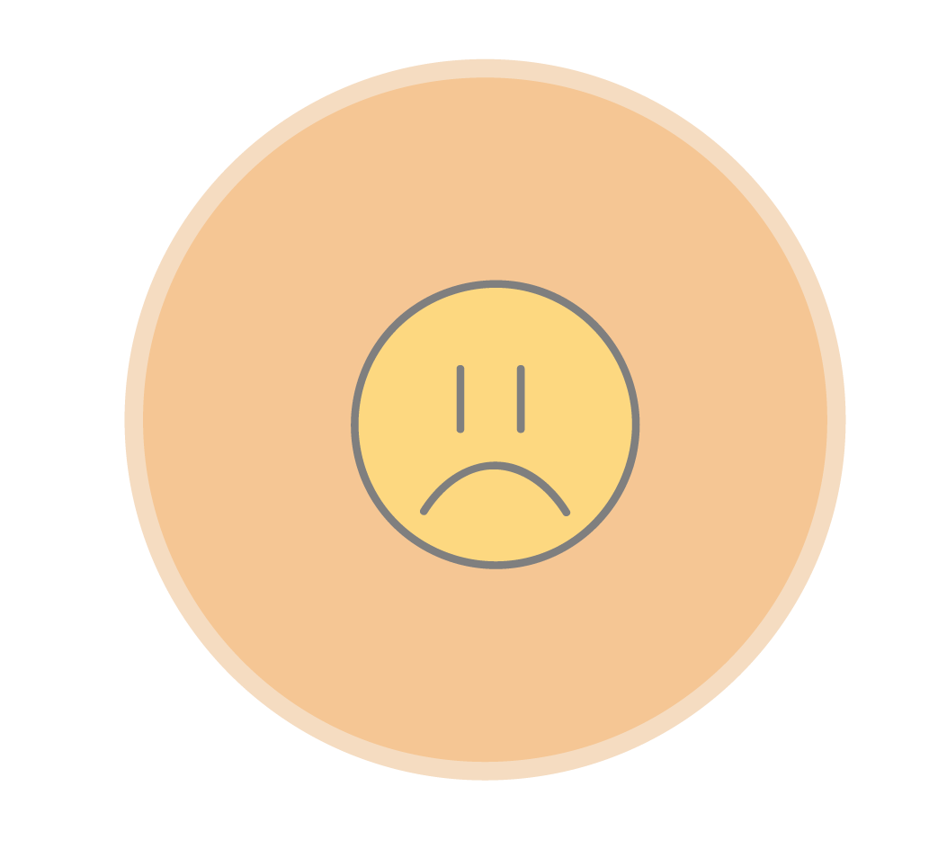
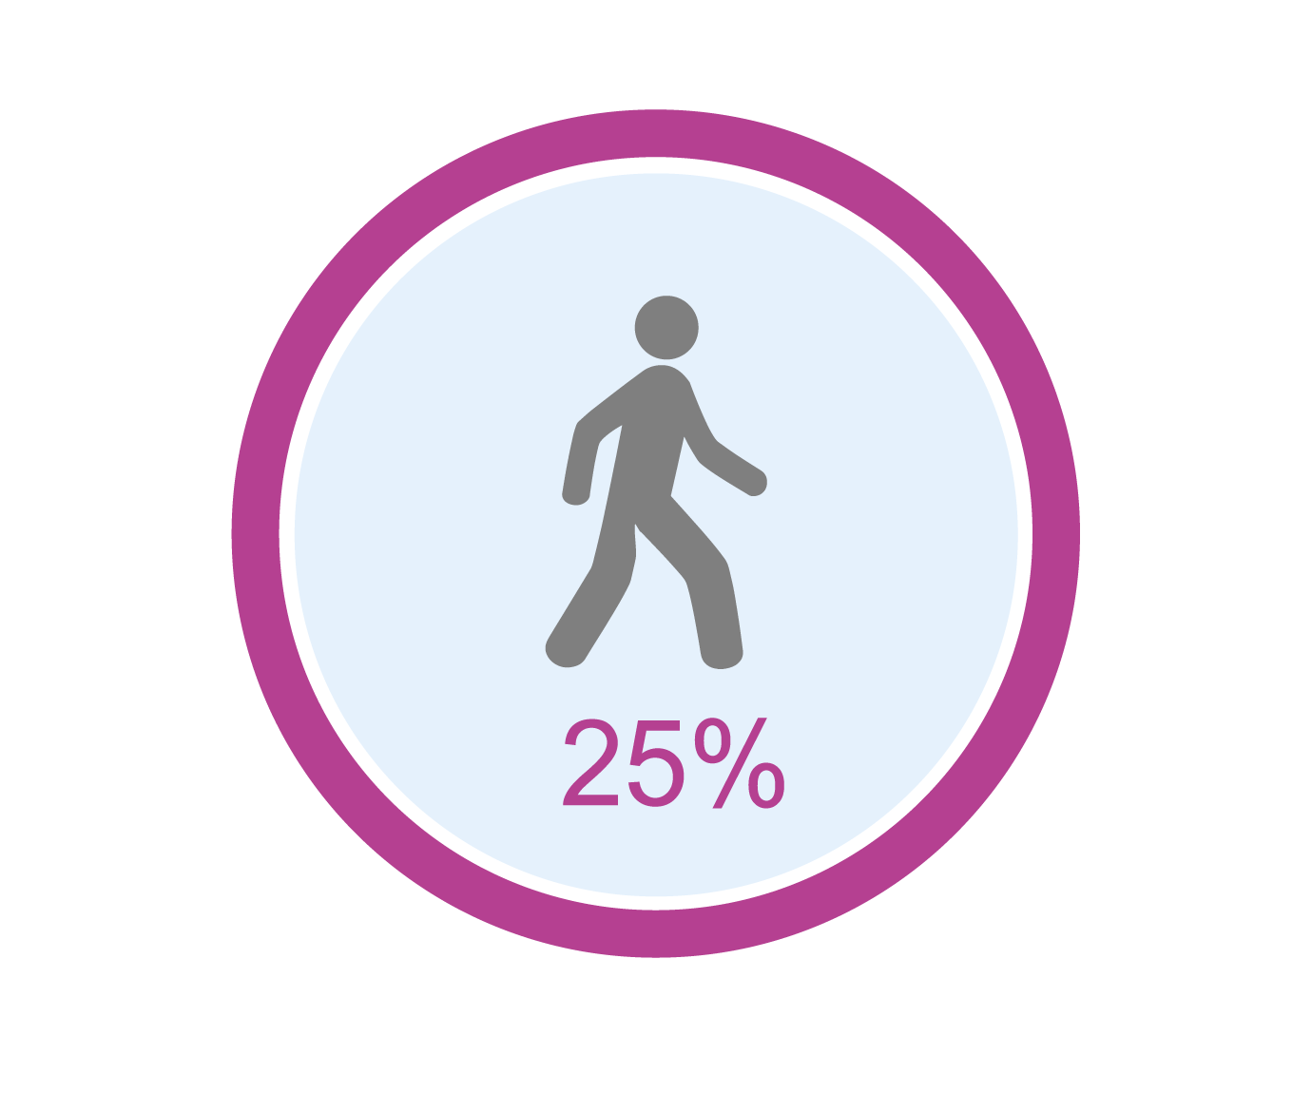
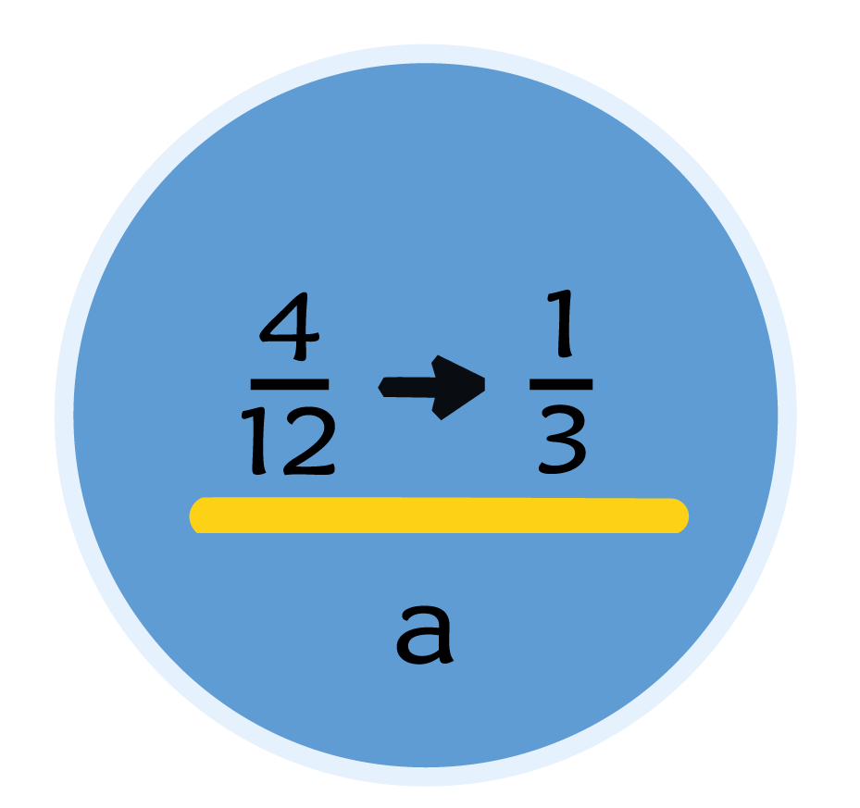
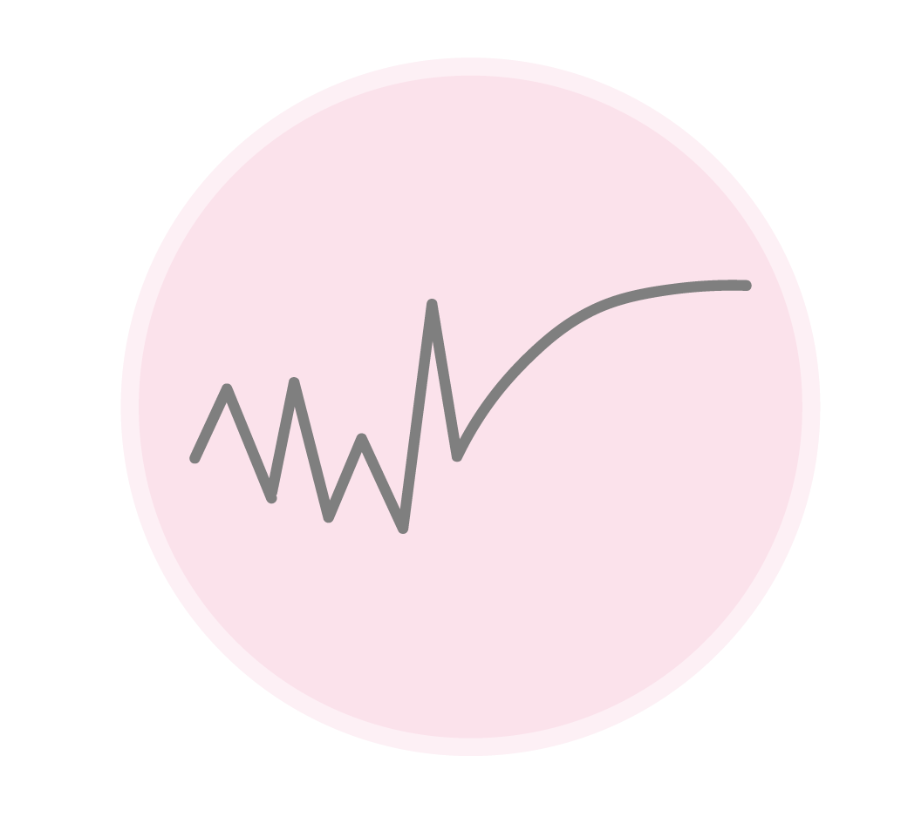
Overview dashboard
Emotion
Cognition
Gynzy Learning objective
Metacognition

Slide 2
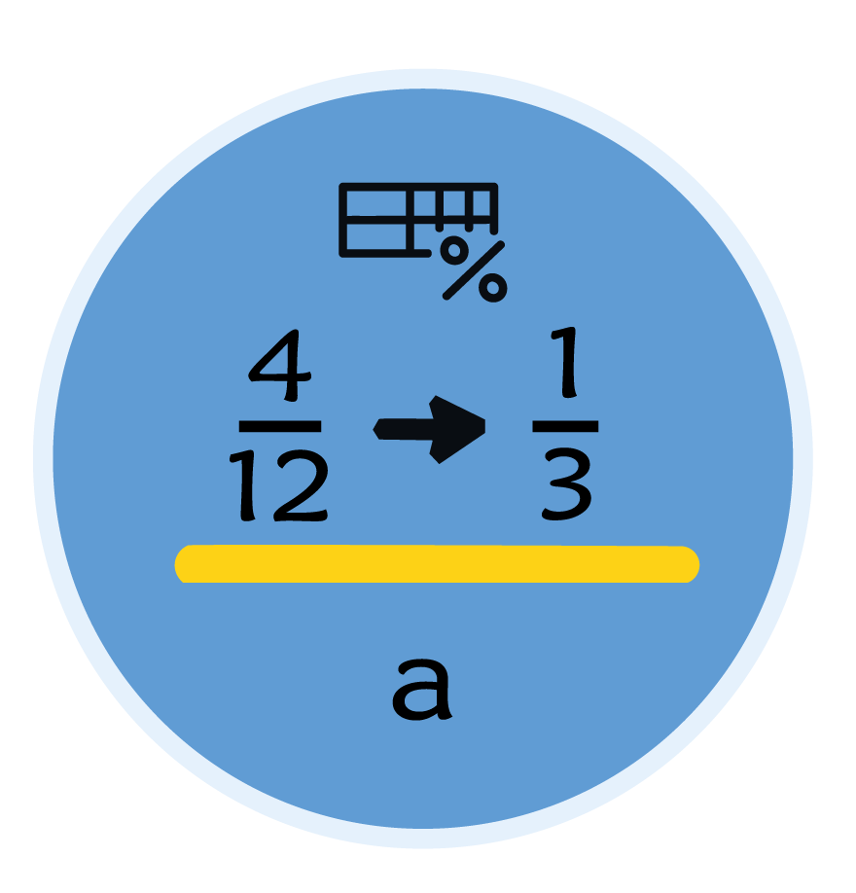
Gynzy Learning objective Screens flow
Gynzy world icon
Gynzy island icon
Gynzy learning objective indicator
Simplyfing fractions

Slide 3
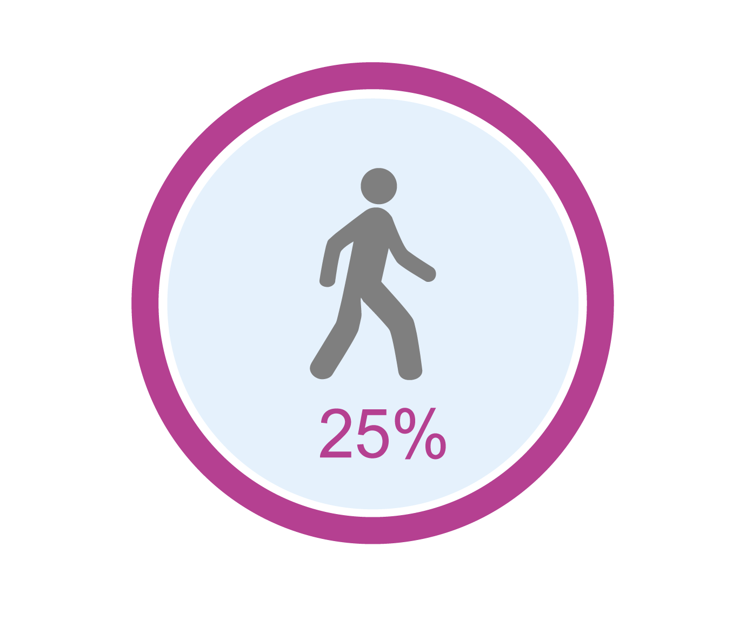
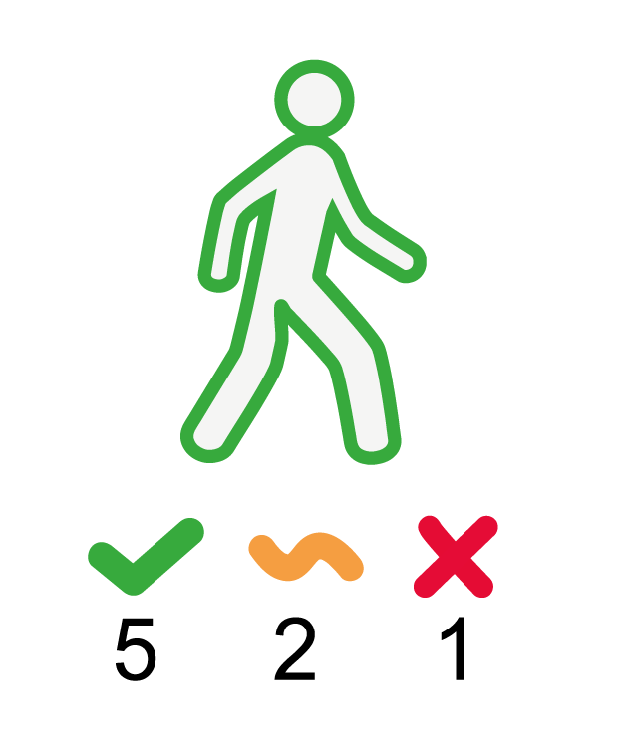
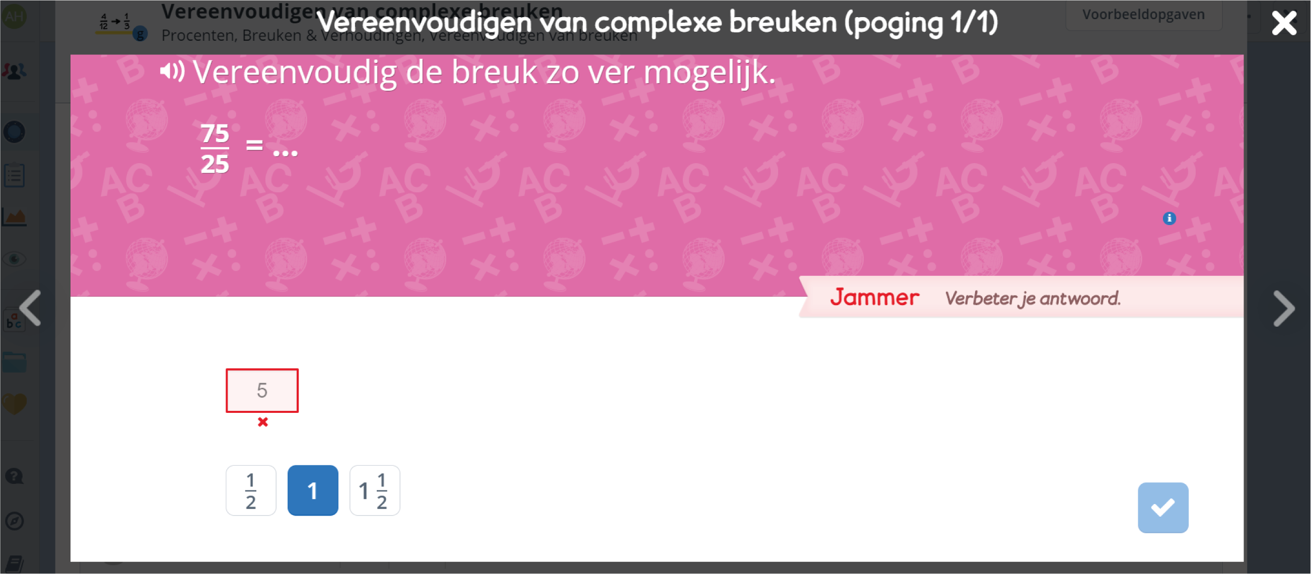
Cognition
Screens flow
Gynzy color performance level
Growth icon
Growth icon
Gynzy answer of the student
Gynzy performance level
Amount of correct answers;
second attempt correct;
wrong answers

Slide 4











Cognition possibilities
Growth in
performance
Gynzy performance level below 25%
No growth or decrease
Gynzy performance level
between 25%-75%
Decrease in
performance
Gynzy performance level above 75%
Idle

Slide 5

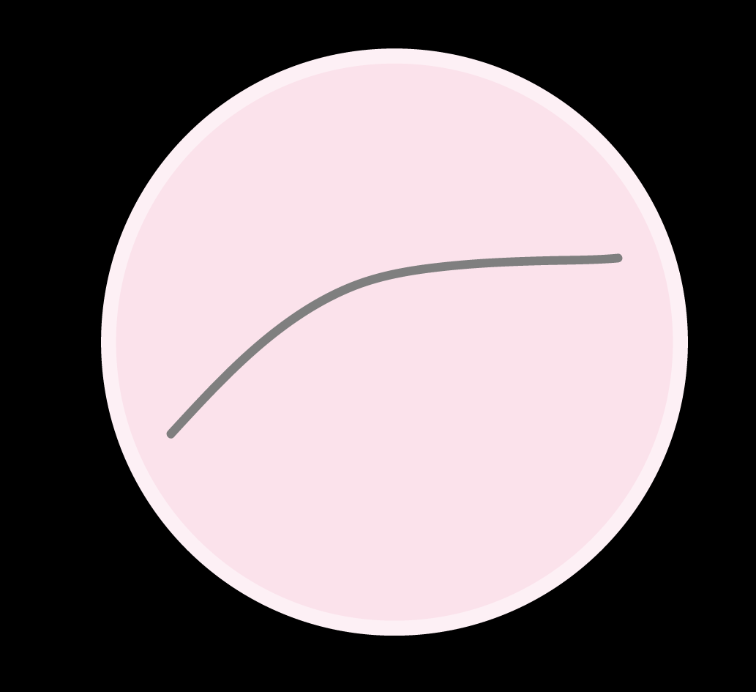

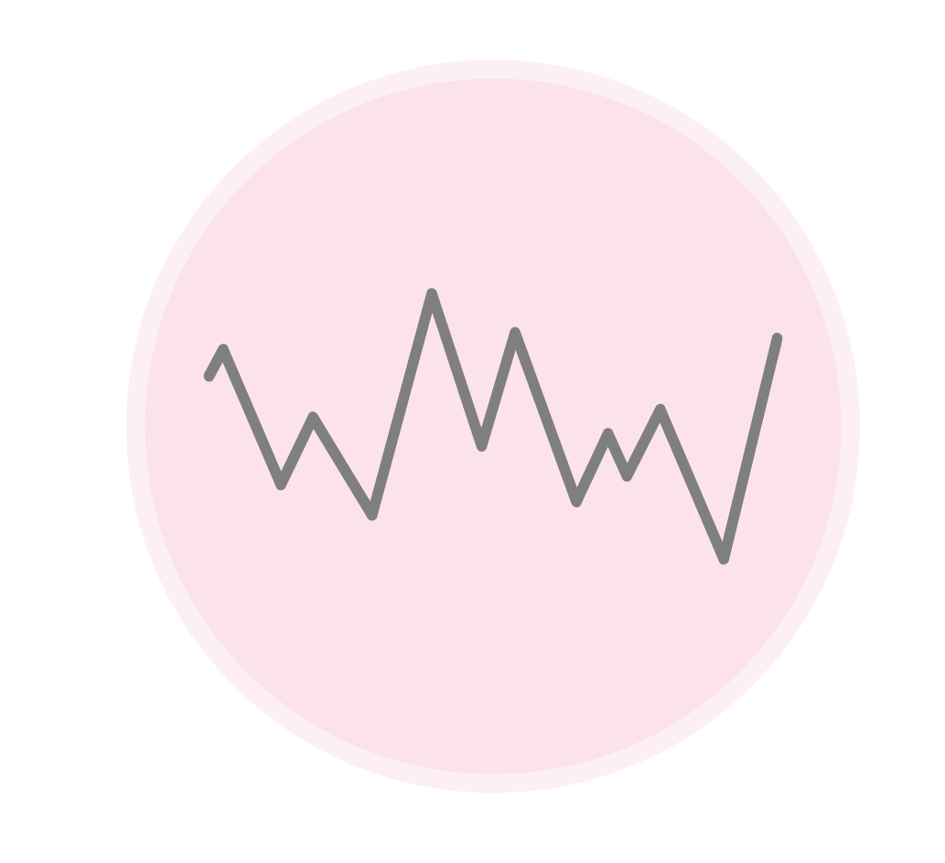
Metacognition
High swimmer: Immediate drop
Moment-by-moment
Learning curve
Quick riser: Immediate peak
Riser in two stages: Double spikes
Slow riser: Close multiple spikes
Riser and descender: Separate multiple spikes

Slide 6
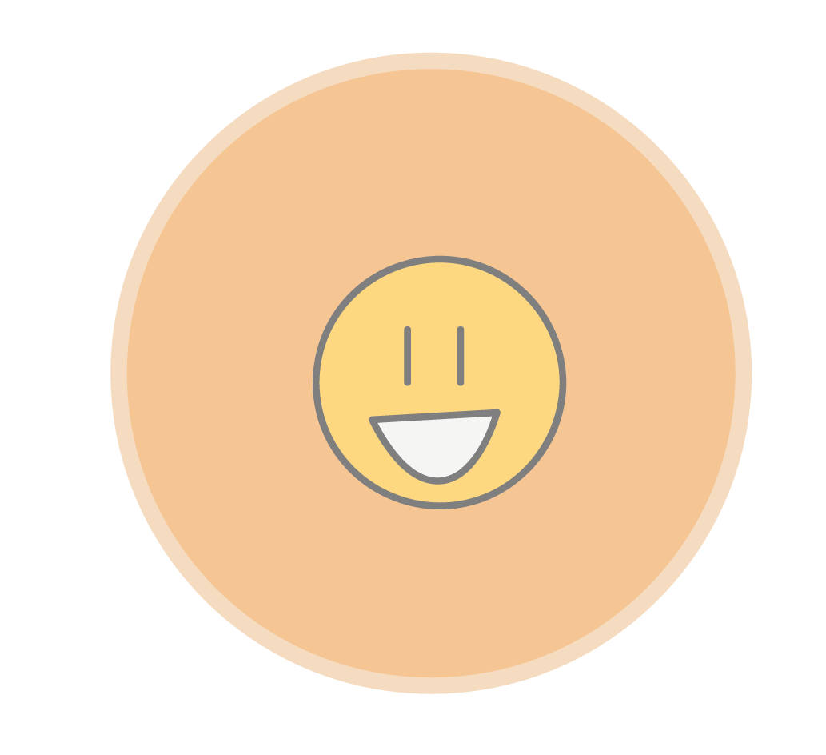
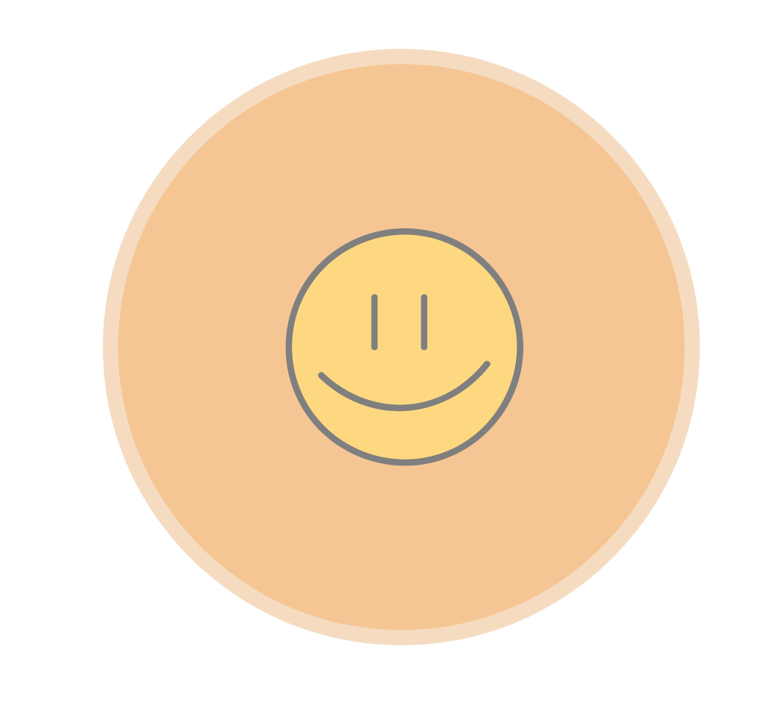
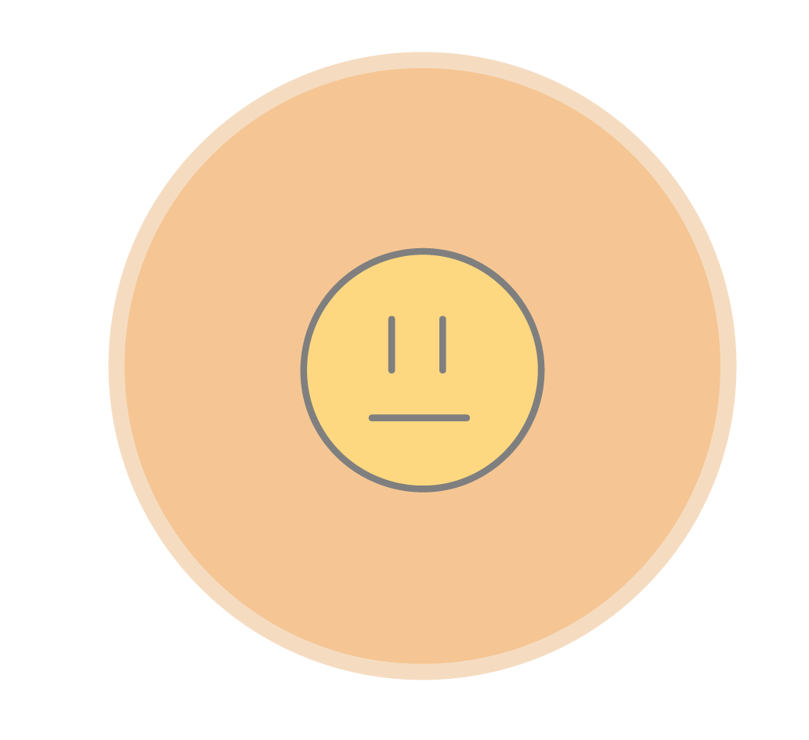

Emotion
Possibilities
Emotion of the student

